Slide 1

ANALYTICS BY DREMIO

Slide 2
Tools &Technology Stack
Data-set : Excel, CSV.
Data Lake Engine : Dremio
Analytic Tool: Any Bi Tool (Power Bi, Tableau, etc).
Dremio is an open source project that enables business analysts and data scientists to explore and analyze any data at any time, regardless of its location, size, or structure.
Dremio provides an almost self-service data platform that allows you to create virtual data-sets from multiple sources and serves as a read-only database while also providing simple configurations for modern data visualization tools, such as Tableau, Power BI, Qlik Sense and more.

Slide 3
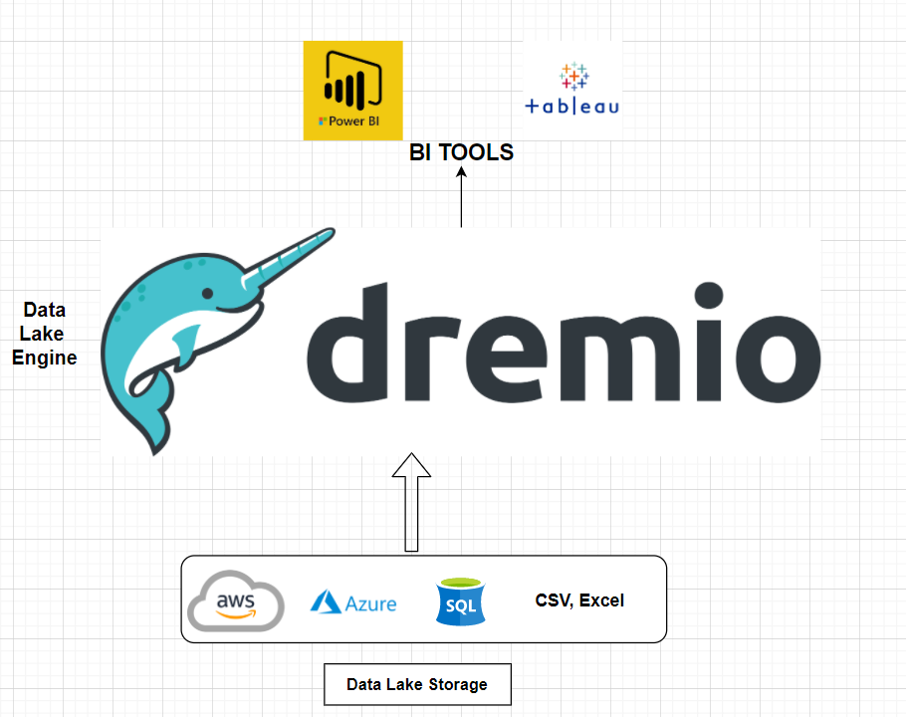
Architecture
.
.

Slide 4
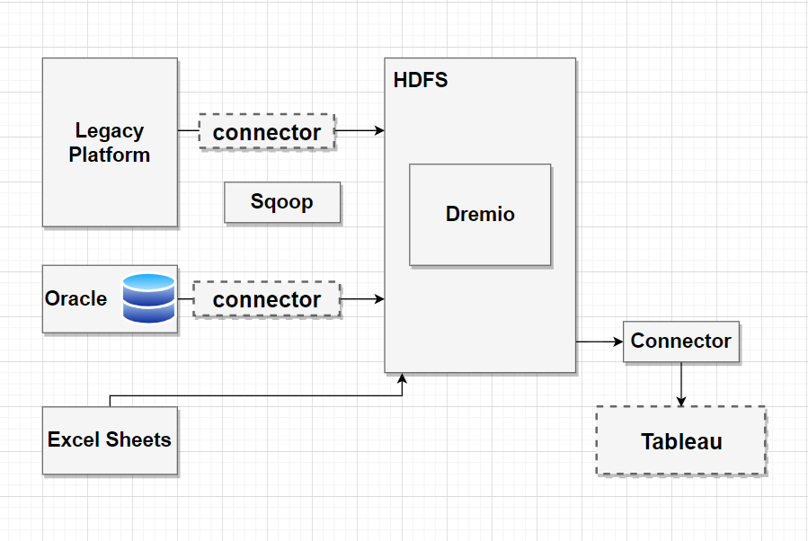
BI TOOL

Slide 5
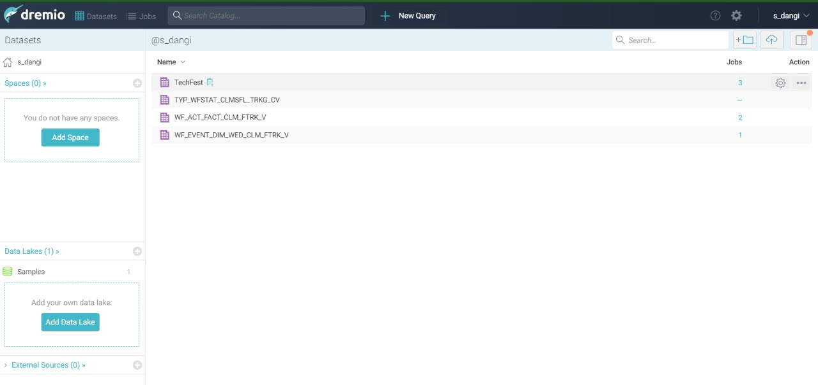
Data Fetched in Dremio.

Slide 6
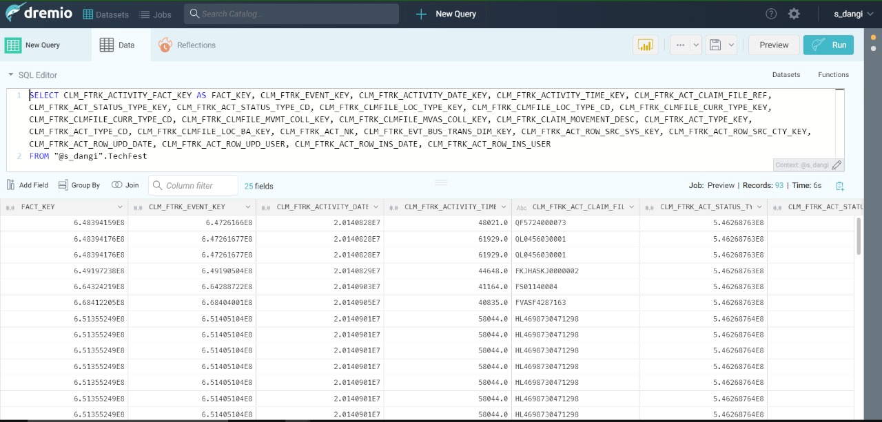

Slide 7
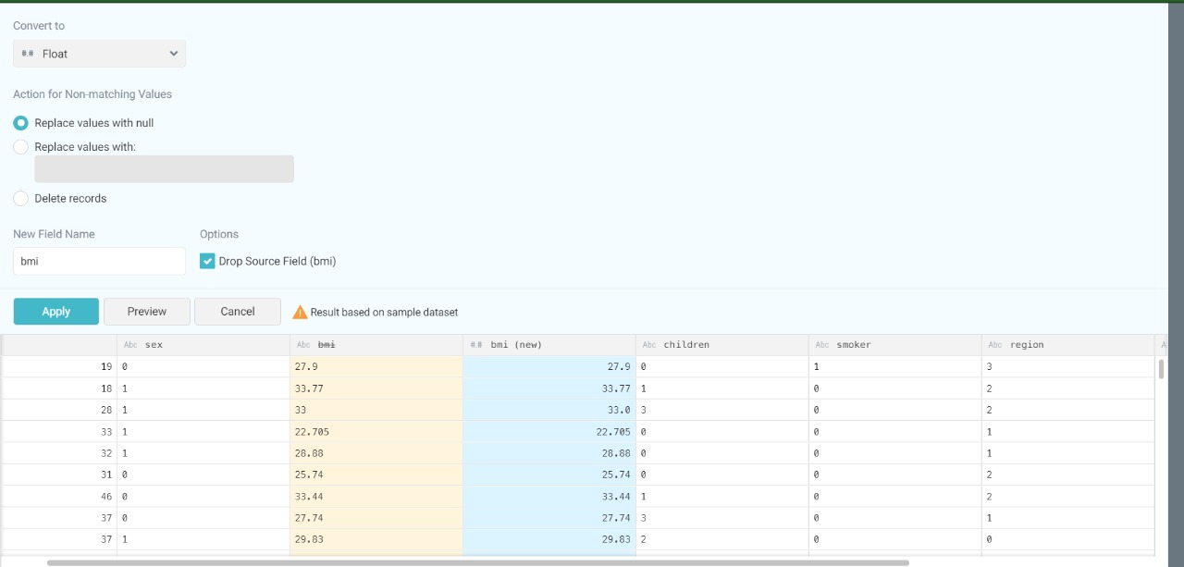
Data Conversions in Dremio.

Slide 8
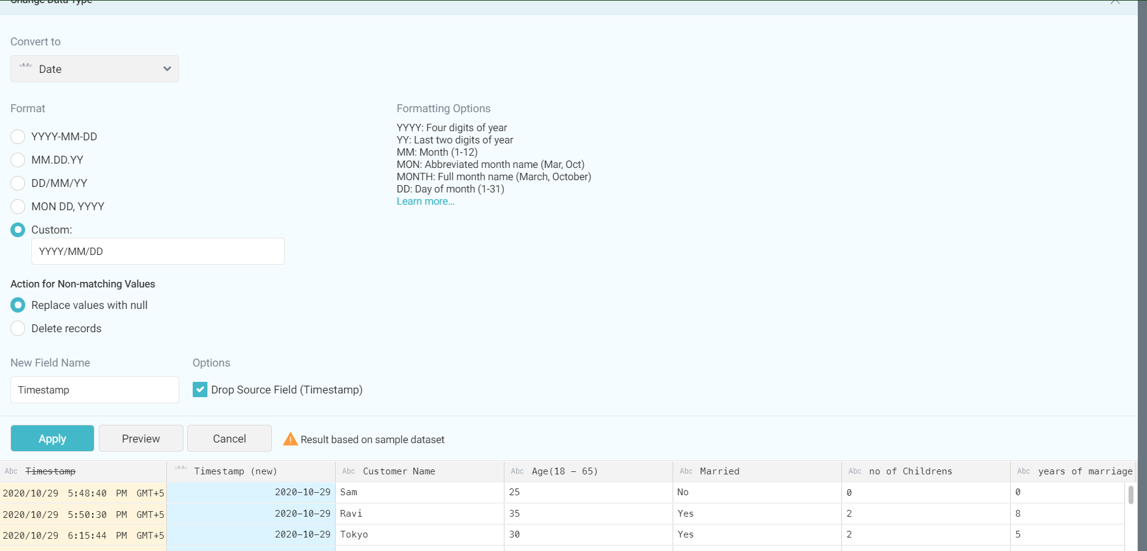

Slide 9
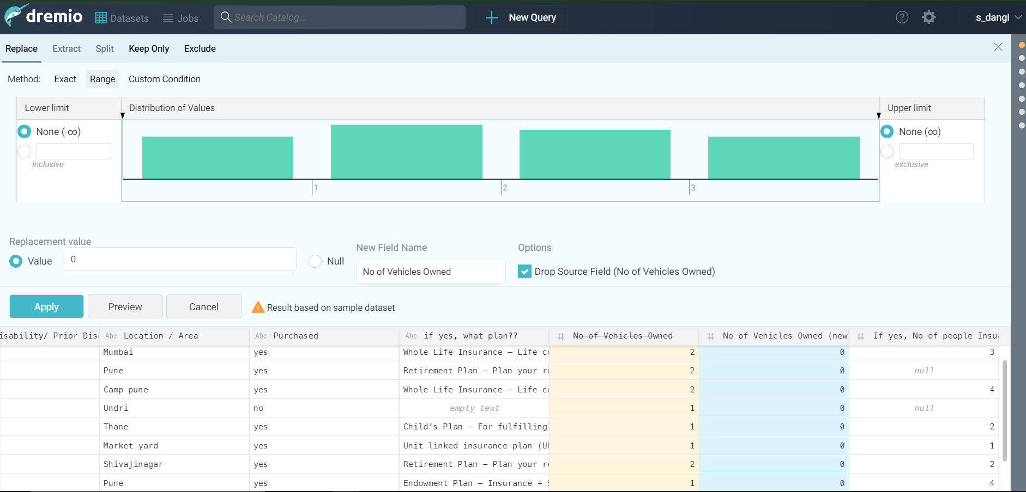

Slide 10
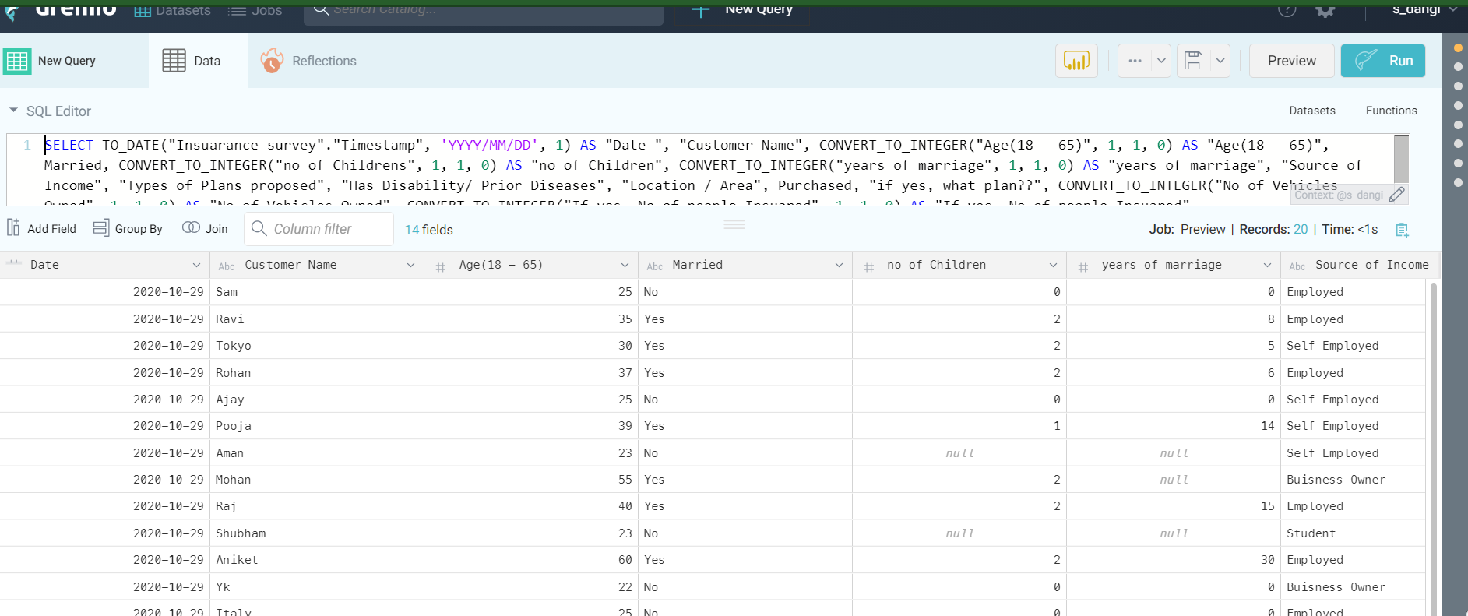

Slide 11
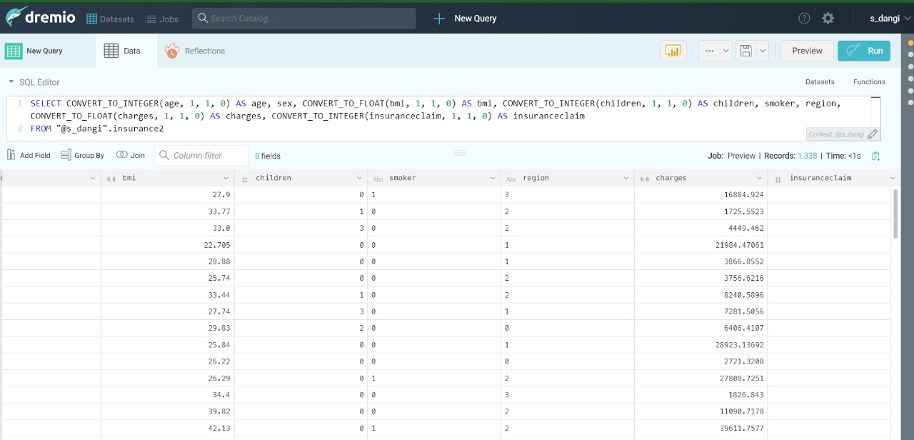

Slide 12
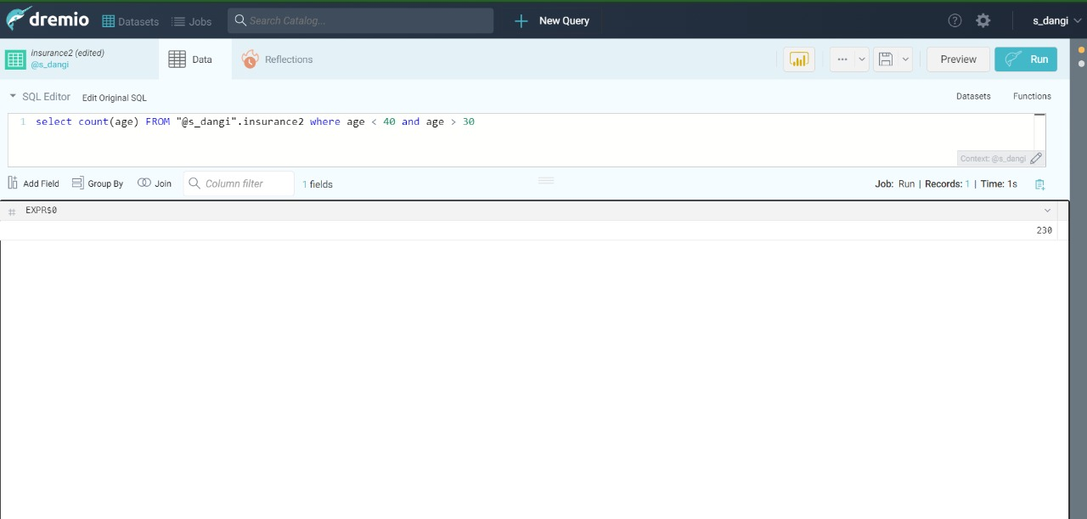
Dremio provides comprehensive SQL access to your data, no matter where it is stored.

Slide 13
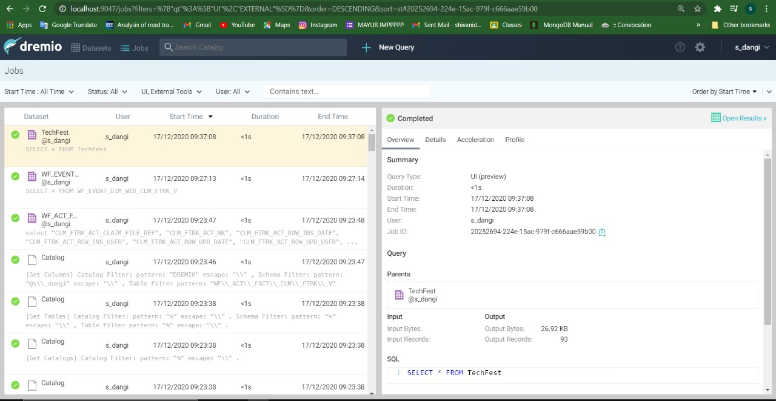
Job Handling in Dremio

Slide 14
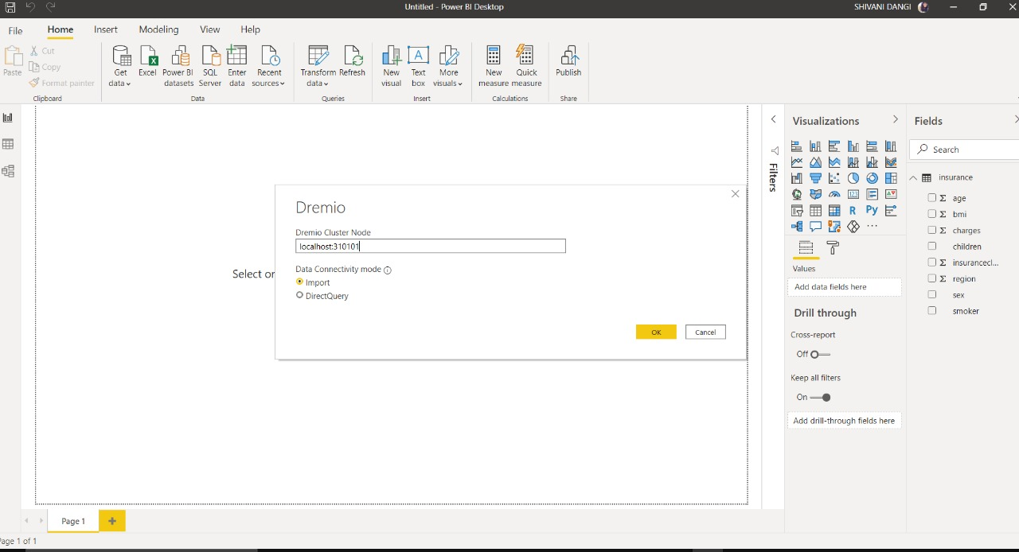
Dremio Connection to BI Tools.

Slide 15
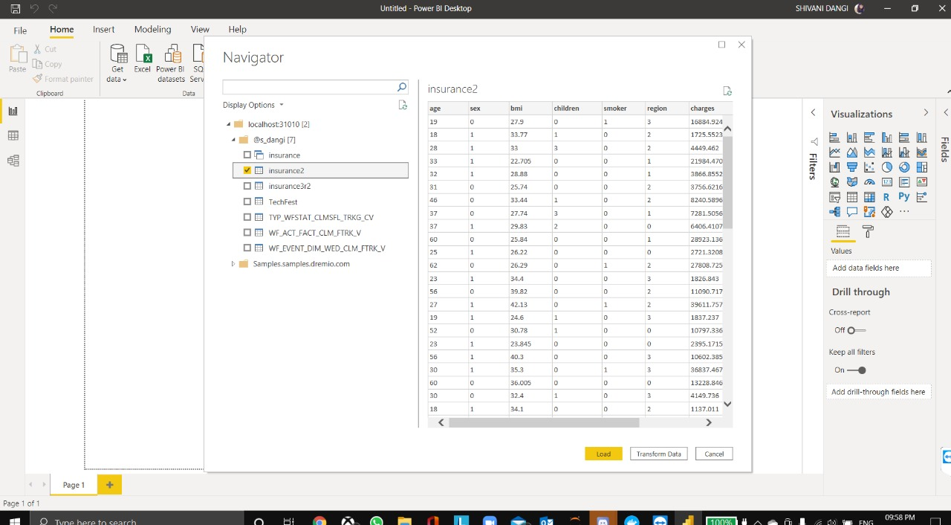
BI Tool For Visualizations.

Slide 16
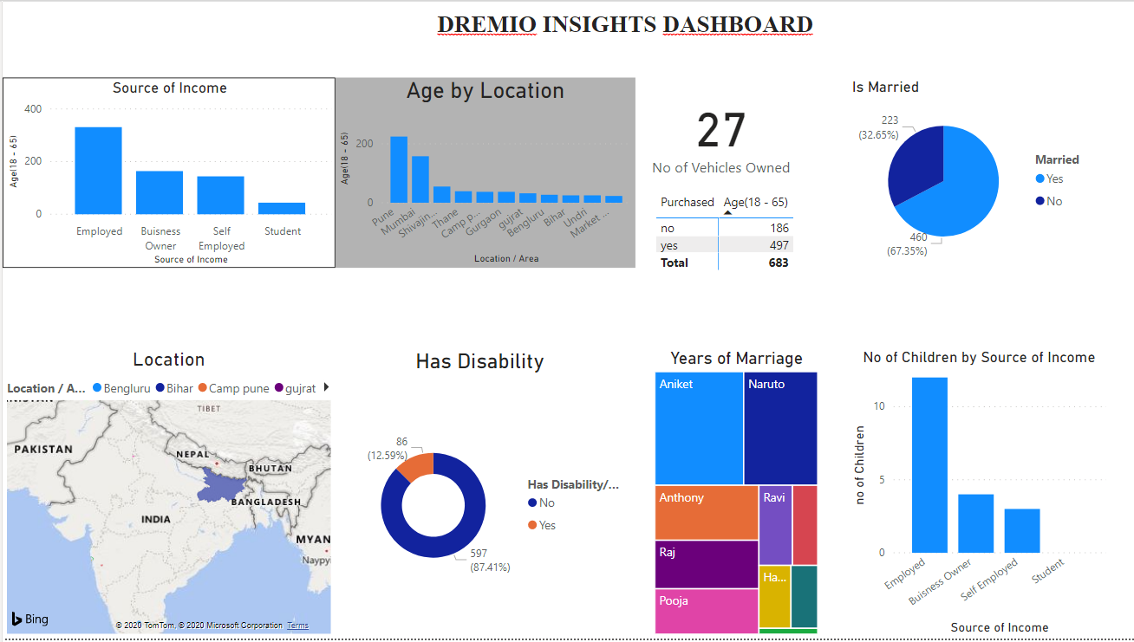
Dashboard Design

Slide 17
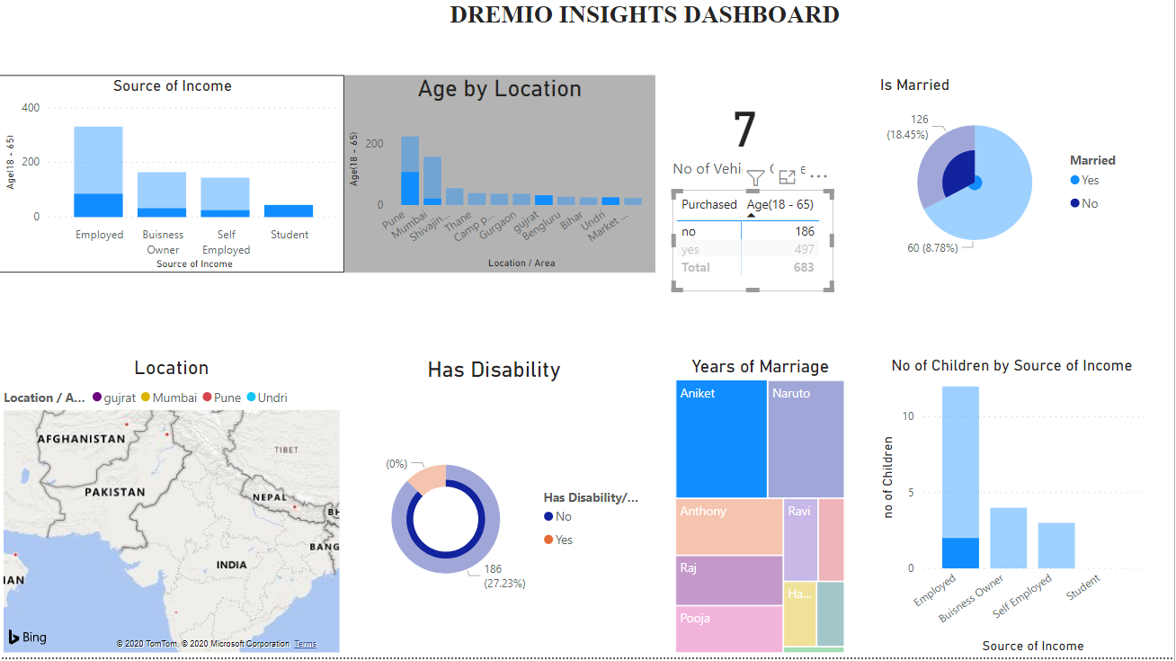
Dashboard Design

Slide 18
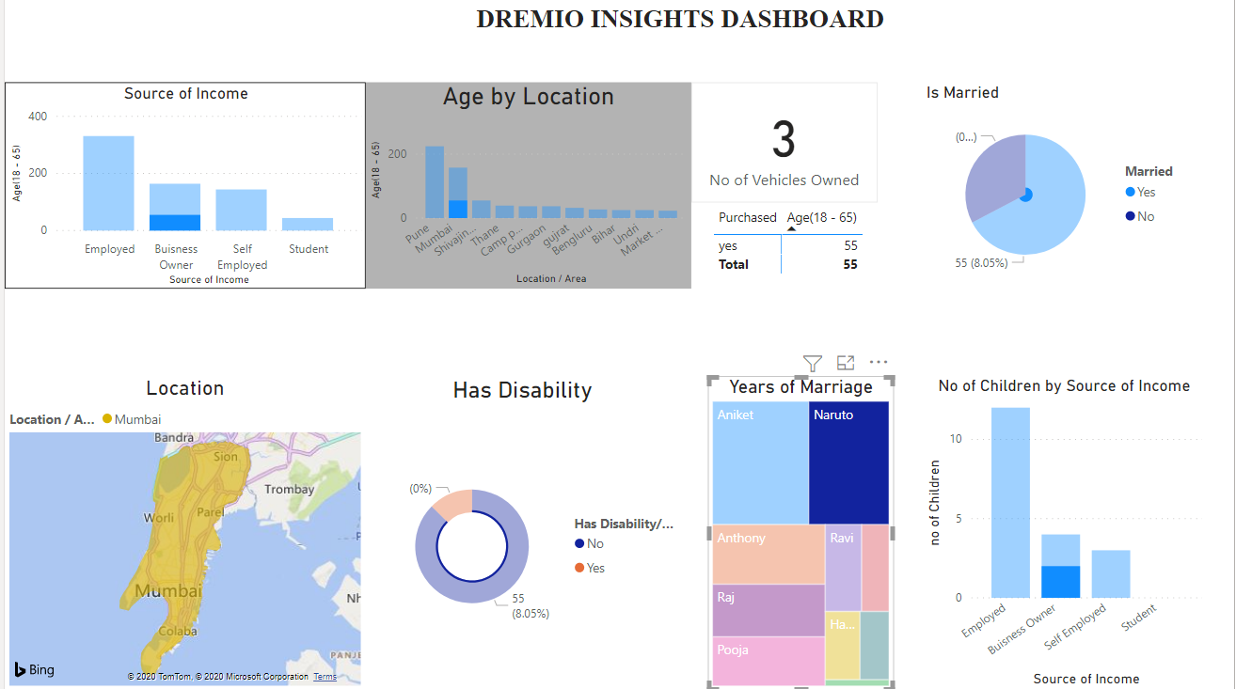

Dashboard Design

Slide 19

Thank you!
Shivani Dangi
Dikshant Oswal

